Slide 1
B Trees - Motivation
Recall our discussion on AVL-trees
  The maximum height of an AVL-tree with n-nodes is log2(n) since the branching factor (degree, fanout) of each node in an AVL-tree is 2 and an AVL-tree is height-balanced
  If we have 1 million nodes in the tree, the height is log2(1 million) ~ 20
  If we have 1 billion nodes in the tree, the height is log2(1 billion) ~ 30

Slide 2
B Trees - Motivation
To reach an item residing at the deepest level
  Have to visit 20/30 nodes starting at the root
What if the tree nodes do not fit into memory
  Will be the case if we have millions of nodes in the tree
  Then we have to retrieve the visited nodes from the disk
  Disk access is very slow
    Each block retrieval takes ~ 20ms from a hard-disk. Retrieving 20 nodes will take ~4 seconds.
Solution? B Trees
  Increase the branching factor of nodes while keeping the tree balanced so that the height of the tree will be small
  If branching factor is 10, then the height is log10(1 billion) = 9, if the branching factor is 100, then the height is log100(1 billion) = 5

Slide 3
B Trees
B-Trees are multi-way search trees commonly used in database systems or other applications where data is stored externally on disks and keeping the tree shallow is important.
A B-Tree of order M has the following properties:
  The root is either a leaf or has between 2 and M children.
  All nonleaf nodes (except the root) have between |M/2| and M children.
  All leaves are at the same depth.

Slide 4
B Trees
Several variations on the general idea
  The actual data is stored in both the leaves and the internal nodes
    This is typically called the B tree in literature
  The actual data is stored ONLY at the leaves. Internal nodes ONLY contain keys to guide the search to the actual data stored at the leaves
    This is what your book calls the B tree. But this version is typically called the B+ tree in literature
    We will cover this version in this class

Slide 5
B Trees
A B Tree of order M has the following properties:
  The root is either a leaf or has between 2 and M children.
  All nonleaf nodes (except the root) have between |M/2| and M children.
  All leaves are at the same depth.
  All data records are stored at the leaves.
    Leaves store between |L/2| and L data records.
    L depends on disk block size and data record size (e.g. L = M).

Slide 6
B Tree Details
Each internal node of a B-tree has:
  Between |M/2| and M children.
  up to M-1 keys k1 < k2 < ... < kM-1
k1 ….. ki-1 ki …….kM-1
Keys are ordered so that:
k1 < k2 < ... < kM-1

Slide 7
Properties of B-Trees
k1 ….. ki-1 ki …….kM-1
T1
Ti
TM
Children of each internal node are "between" the items in that node.
Suppose subtree Ti is the i^{th} child of the node:
  All keys in Ti must be between ki-1 and ki
    i.e. ki-1 ≤ Ti < ki
  ki-1 is the smallest key in Ti
  All keys in first subtree T1 < k1
  All keys in last subtree TM ≥ kM-1

Slide 8
B-Tree Example
B-tree of order 3: also known as 2-3 tree (2 to 3 children)
- means empty key
22: -
16: -
41: 58
8, 11, 12
16, 17
22, 23, 31
41, 52
58, 59, 61
Apply B-tree definition for order M = 3 and L = M = 3
  Each node must have at least |M/2| = 2 and at most M = 3 children
  Leaves store between |L/2| = 2 and L = 3 data records

Slide 9
Searching for a key in the B tree
Searching a B-tree is much like searching a binary-tree, except that instead of making a “two-way” branching decision at each node, we make a “multi-way” branching decision according to the number of the node’s children.
Search for 52 in the following 2-3 tree
22: -
16: -
41: 58
8, 11, 12
16, 17
22, 23, 31
41, 52
58, 59, 61

Slide 10
Inserting Items in B Trees
Insert X: Do a Search on X and find appropriate leaf node
  If leaf node is not full, fill in empty slot with X.
22: -
16: -
41: 58
8, 11, 12
16, 17
22, 23, 31
41, 52
58, 59, 61
Insert 18
22: -
16: -
41: 58
8, 11, 12
16, 17, 18
22, 23, 31
41, 52
58, 59, 61

Slide 11
Inserting Items in B Trees
Insert X: Do a Search on X and find appropriate leaf node
  If leaf node is full, split leaf node and adjust parents up to root node.
22: -
16: -
41: 58
8, 11, 12
16, 17, 18
22, 23, 31
41, 52
58, 59, 61
Insert 1
22: -
11: 16
41: 58
1, 8
11, 12
16, 17, 18
22, 23, 31
41, 52
58, 59, 61

Slide 12
Insertion in B Trees: Insert 19
22: -
11: 16
41: 58
1, 8
11, 12
16, 17, 18
22, 23, 31
41, 52
58, 59, 61
Insert 19
22: -
11: 16
41: 58
1, 8
11, 12
16, 17
18, 19
22, 23, 31
41, 52
58, 59, 61
Split (11:16)

Slide 13
Insertion in B Trees: Insert 28
Split (11:16) into 2 nodes (11: -) and (18: -)
Push 16 to the root
16: 22
11: -
18: -
41: 58
1, 8
11, 12
16, 17
18, 19
22, 23, 31
41, 52
58, 59, 61
Insert 28: Split (22, 23, 31) into 2 nodes
16: 22
11: -
18: -
41: 58
1, 8
11, 12
16, 17
18, 19
22, 23
28, 31
41, 52
58, 59, 61

Slide 14
Insertion in B Trees: Insert 28
Insert 28: Split (28:41:58) into 2 nodes
(28: -) and (58: -) and push 41 to the root
16: 22
11: -
18: -
28: -
58: -
1, 8
11, 12
16, 17
18, 19
22, 23
28, 31
41, 52
58, 59, 61
Can’t insert 41 to the root: Split the root,
(16:22:41) into two nodes (16: -), (41: -),
create a new root and push 22 to
the new root
22: -
16: -
41: -
11: -
18: -
28: -
58: -
1, 8
11, 12
16, 17
18, 19
22, 23
28, 31
41, 52
58, 59, 61

Slide 15
Pseudocode for Btree Insert
Search the Btree and find the leaf node where the key will be inserted
If the leaf has enough space, insert the key into the leaf and your are done
Otherwise, split the leaf into 2 leaves. Now you have a (key, child) pair that needs to be inserted into the parent
If parent has enough space, insert
Otherwise split the parent, and propagate this process up in the tree

Slide 16
Deleting Items from B Trees
Delete X: Do a Search on X and delete the value from leaf node
  May have to combine leaf nodes and adjust parents up to root node if number of data items falls below |L/2| = 2
    E.g. Delete 59 in the tree below – Case 1 – Simple case
16: 22
11: -
18: -
41: 58
1, 8
11, 12
16, 17
18, 19
22, 23, 31
41, 52
58, 59, 61
Delete 59

Slide 17
Deletion in B Trees: Delete 52
16: 22
11: -
18: -
41: 58
1, 8
11, 12
16, 17
18, 19
22, 23, 31
41, 52
58, 61
Delete 52: Leaf (41,-) has a single key. But
Left sibling has 3 keys. So borrow 1 key
from the sibling – Case 2
16: 22
11: -
18: -
31: 58
1, 8
11, 12
16, 17
18, 19
22, 23
31, 41
58, 61

Slide 18
Deletion in B Trees: Delete 23
16: 22
11: -
18: -
31: 58
1, 8
11, 12
16, 17
18, 19
22, 23
31, 41
58, 61
Delete 41: Node (31, 41) now has (31: -).
We can’t borrow from any of the siblings.
So we combine with one of them
16: 22
11: -
18: -
58: -
1, 8
11, 12
16, 17
18, 19
22, 23, 31
58, 61

Slide 19
Deletion in B Trees: Delete 17
16: 22
11: -
18: -
58: -
1, 8
11, 12
16, 17
18, 19
22, 23, 31
58, 61
Delete 17: Node now has (16: -). Must
Combine with (18, 19). Now the parent has
A single child! So must combine the siblings
22: -
11: 16
31: -
1, 8
11, 12
16, 18, 19
22, 23, 31
58, 61

Slide 20
Pseudocode for Btree Delete
Search the Btree and find the leaf node containing the key, and delete the key from the leaf
If the leaf still has enough keys, your are done
Otherwise, try borrowing from the right OR left siblings. If this is possible, then you are done
Otherwise, merge with the right OR left sibling. Now the porent has one less child.
If the parent still has enough children you are done. Otherwise, apply the same procedure to this internal node, and propagate the process up the tree

Slide 21
Choosing M and L Parameters
If Tree & Data in internal (main) memory
  We want M and L to be small to minimize search time at each node/leaf
    Typically M = 3 or 4 (e.g. M = 3 is a 2-3 tree)
    All N items stored in internal memory
If Tree & Data on Disk then Disk access time dominates!
  Choose M & L so that interior and leaf nodes fit on 1 disk block
  To minimize number of disk accesses, minimize tree height
  Typically M = 32 to 256, so that depth = 2 or 3 allows very fast access to data in large databases.

Slide 22
Efficient Range Searches with B Trees
Consider the following database query
  Find all students whose keys are between ID1 and ID2
  Find all records whose keys are between “G and R”
  Find all cities whose names start with D
  …

Slide 23
Efficient Range Searches with B Trees
To solve range queries efficiently, the leaves of a B tree are typically linked together in a doubly linked list as shown below
22: -
16: -
41: -
11: -
18: -
28: -
58: -
1, 8
11, 12
16, 17
18, 19
22, 23
28, 31
41, 52
58, 59, 61

Slide 24
Efficient Range Searches with B Trees
Find all records whose keys are between “16 and 28”
Do a search to find “16” within the leaf node “16, 17”
Then simply follow the links to the adjacent leafs until we hit the leaf containing “28”
Notice that we only accessed 3 internal and 4 leaf nodes to execute the whole query.
22: -
16: -
41: -
11: -
18: -
28: -
58: -
1, 8
11, 12
16, 17
18, 19
22, 23
28, 31
41, 52
58, 59, 61

Slide 25
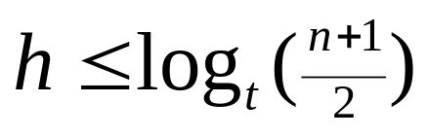
The height of a B tree
If n >= 1, then for any n-key B-tree T of height h and minimum degree |M/2| = t >=2,
Proof: If a B-tree has height h, the root contains at least one key and all other nodes contain at least t-1 keys. Thus,
    there is one node at depth 0, which is the root
    there are at least 2 nodes at depth 1
    at least 2t nodes at depth 2
    at least 2t² nodes ad depth 3 and so on
    until at depth “h” there are at least 2t^{(h-1)} nodes.
  Let’s look at the next slide for an illustration of the above statement.

Slide 26
The height of a B tree
# of nodes
root
1
1
t-1
t-1
2
t
t
t-1
…………
t-1
t-1
………….
t-1
2t
t
t
t
t
2t²
t-1
….
t-1
t-1
….
t-1
t-1
….
t-1
t-1
….
t-1
  A B-tree of height 3 containing a minimum possible number of keys. Shown inside each node x is |M/2|-1, that is, the # of keys contained within the node.

Slide 27
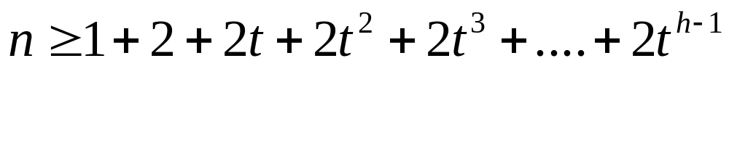
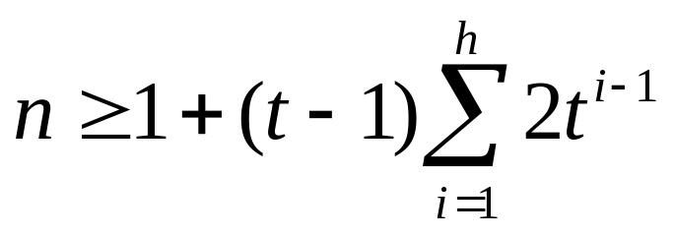
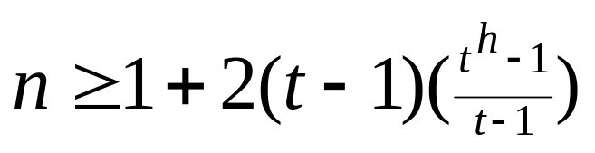
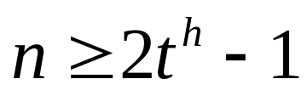
The height of a B tree

Slide 28
Summary of Search Trees
Binary Search Trees: Allow faster search compared to linear linked lists. But the shape of the tree depends on the order of insertion. So the tree might degenerate to a linked list.
AVL trees: Insert/Delete operations keep tree balanced. Complicated insertion/deletion. Extra space for balancing factor
Splay trees: Sequence of operations produces more-or-less balanced trees. Active nodes move up the tree, which allows for faster access next time they are accessed
Multi-way search trees (B, B+ Trees): More than two children per node allows shallow trees; all leaves are at the same depth keeping tree balanced at all times. Good for huge data sets and used in database management systems, where the data does not fit in main memory and stored on disk.

